Slide 1
Chapter 17 Component-based software engineering
基于组件的软件工程
Lecture 1
Chapter 17 Software reuse

Slide 2
Topics covered
17.1 Components and component models 组件和组件模型
17.2 CBSE processes 基于组件的软件工程 的开发流程
17.3 Component composition 组件合成
Chapter 17 Software reuse

Slide 3
Component-based development 基于组件开发
Component-based software engineering (CBSE) is an approach to software development that relies on the reuse of entities called ‘software components’. (CBSE is the process of defining, implementing, and integrating or composing loosely coupled, independent components into systems)
It emerged from the failure of object-oriented development to support effective reuse in the late 1990s. Single object classes are too detailed and specific.
Components are more abstract (defined by their interfaces) than object classes and can be considered to be stand-alone service providers. They can exist as stand-alone entities.
CBSE是一种软件开发方法,依赖于称为“软件组件”实体的重用。(CBSE是定义、实现、集成或组合松耦合的独立的组件到系统)
90年代末期，它是来自于面向对象开发的挫折，不能像人们最初所期待的那样完成广泛的复用，单个对象类有太多的细节且太特殊。
组件是比对象类更抽象的(通过他们的接口定义),可以被认为是独立的服务提供者。他们可以作为独立的实体存在。
Chapter 17 Software reuse

Slide 4
CBSE essentials 基于组件软件工程 要素
The essentials of CBSE are:
Independent components specified by their interfaces.
Component standards to facilitate component integration.
Middleware that provides support for component inter-operability.
A development process that is geared to reuse.
独立组件由他们的借口完全定义。
组件标准使组件集成变得更为容易。
中间件为组件集成提供软件支持。
开发过程是一种适用于基于组件软件工程的（复用）的开发过程。
Chapter 17 Software reuse

Slide 5
CBSE and design principles
基于组件软件工程和设计原则
Apart from the benefits of reuse, CBSE is based on sound software engineering design principles:
即使不考虑复用的好处，CBSE也也有良好的软件工程设计原则
  Components are independent so do not interfere with each other;
  组件是独立的，因此他们不会影响彼此的操作；
  Component implementations are hidden;组件实现细节是隐藏的
  Communication is through well-defined interfaces;
  组件时通过良好定义的接口交互的；
  Component infrastructures/platforms offer a range of standard services that can be used in application systems. These services are shared and reduce development costs.
  组件基础设施提供一系列可用在应用系统中的标准服务，这样减少了要开发的新代码的量。
Chapter 17 Software reuse

Slide 6
Component standards·组件标准
Standards need to be established so that components can communicate with each other and inter-operate.
Unfortunately, several competing component standards were established:一些竞争的组件标准已经被建立
  Sun’s Enterprise Java Beans(EJB)
  Microsoft’s COM and .NET
  CORBA’s CCM(OMG)(CCM-CORBA Component Model, CORBA-Common Object Request Broker Architecture, OMG-Object Management Group)
In practice, these multiple standards have hindered the uptake of CBSE. It is impossible for components developed using different approaches to work together.
Chapter 17 Software reuse

Slide 7
CBSE problems 基于组件开发问题
Component trustworthiness可信性- how can a component with no available source code be trusted?
Component certification保证 - who will certify the quality of components?
Emergent property prediction总体属性预测 - how can the emergent properties of component compositions be predicted?
Requirements trade-offs需求权衡 - how do we do trade-off analysis between the features of one component and another?
Chapter 17 Software reuse

Slide 8
17.1 Components and component models
组件和组件模型
Components provide a service without regard to where the component is executing or its programming language
  A component is an independent executable entity that can be made up of one or more executable objects;
  The component interface is published and all interactions are through the published interface;
  组件提供了一种服务，不考虑组件在哪里运行或者其编程语言。
  组件时独立可执行的实体，这由它的借口定义。
  组件所提供的服务可以通过其接口得到，而且所有的交互都是通过接口实现的。
Chapter 17 Software reuse

Slide 9
Component definitions 组件定义
People have proposed varying definitions of a component:
Councill and Heinmann:
  A software component is a software element that conforms to a component model and can be independently deployed and composed without modification according to a composition standard.
  组件是一种软件元素，与某个组件模型要求相一致，按照组成标准无需修改即可独立进行部署和组合。
Szyperski:
  A software component is a unit of composition with contractually specified interfaces and explicit context dependencies only. A software component can be deployed independently and is subject to composition by third-parties.组件时具有合同定义的接口和显式的上下文依赖，可独立进行部署并服从第三方的组成的软件单元。
Chapter 17 Software reuse

Slide 10
Component characteristics 组件的特性
Component characteristic | Description
Standardized 标准化 | Component standardization means that a component used in a CBSE process has to conform to a standard component model. This model may define component interfaces, component metadata, documentation, composition, and deployment.
Independent 独立性 | A component should be independent—it should be possible to compose and deploy it without having to use other specific components. In situations where the component needs externally provided services, these should be explicitly set out in a ‘requires’ interface specification.
Composable 可组合性 | For a component to be composable, all external interactions must take place through publicly defined interfaces. In addition, it must provide external access to information about itself, such as its methods and attributes.
Chapter 17 Software reuse

Slide 11
Component characteristics
Component characteristic | Description
Deployable 可部署性 | To be deployable, a component has to be self-contained. It must be able to operate as a stand-alone entity on a component platform that provides an implementation of the component model. This usually means that the component is binary and does not have to be compiled before it is deployed. If a component is implemented as a service, it does not have to be deployed by a user of a component. Rather, it is deployed by the service provider.
Documented 文档化的 | Components have to be fully documented so that potential users can decide whether or not the components meet their needs. The syntax and, ideally, the semantics of all component interfaces should be specified.
Chapter 17 Software reuse

Slide 12
Component as a service provider
组件作为服务提供者
The component is an independent, executable entity. It does not have to be compiled before it is used with other components.
The services offered by a component are made available through an interface and all component interactions take place through that interface.
The component interface is expressed in terms of parameterized operations and its internal state is never exposed.
组件时独立可执行的实体，这是由它的接口定义的
组件所提供的服务可以通过其接口得到，而且所有的交互也是通过接口实现的。
组件接口表现为参数化的过程，其内部状态不会暴露出来的
Chapter 17 Software reuse

Slide 13
Component interfaces·组件接口
Components have two related interfaces:两种组件接口
‘Provides’ interface 提供接口
  Defines the services that are provided by the component to other components.定义了组件所提供的服务
  This interface, essentially, is the component API. It defines the methods that can be called by a user of the component. 这个接口主要是组件的API，它定义了组件用户可以调用的方法。
‘Requires’ interface需求接口
  Specifies what services must be provided by other components in the system if a component is to operate correctly. If these are not available, then the component will not work.
  This does not compromise the independence or deployability of a component because the ‘requires’ interface does not define how these services should be provided.
Chapter 17 Software reuse

Slide 14
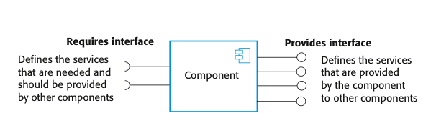
Component interfaces 组件接口
In the UML component diagram, the ‘provides’ interface is a circle and the ‘requires’ interface is a semicircle, at the end of a line from the component icon在UML中，提供接口是一个圆形，一个需求接口的标志是用一个半圆形来表示，半圆位于始于组件图标的一条线段的末端;
Note UML notation符号. Ball 球(Provides interface) and sockets 球洞(Requires interface) can fit together.
Chapter 17 Software reuse

Slide 15
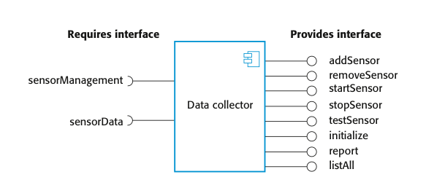
Example: A model of a data collector component
数据采集器组件的模型
This figure shows a model of a component that has been designed to collect information from an array of sensors. It runs autonomously to collect data over a period of time and, on request, provides collected data to a calling component.
The ‘provides’ interface includes methods, such as addSensor(), removeSensor(),…;
These methods have associated parameters specifying the sensor identifiers, locations and so on.
The ‘requires’ interface is used to connect the component to the sensors.
Chapter 17 Software reuse

Slide 16
17.1.1 Component models 组件模型
A component model is a definition of standards for component implementation, documentation and deployment.组件模型定义了组件实现、文档化和部署的标准。
Examples of component models 组件模型-例子
  EJB model (Enterprise Java Beans)
  COM+ model (.NET model)
  Corba Component Model(CCM) (Corba - Common Object Request Broker Architecture)
The component model specifies how interfaces should be defined and the elements that should be included in an interface definition.组件模型明确接口应该怎样定义，还有定义组件接口的要素
Chapter 17 Software reuse

Slide 17
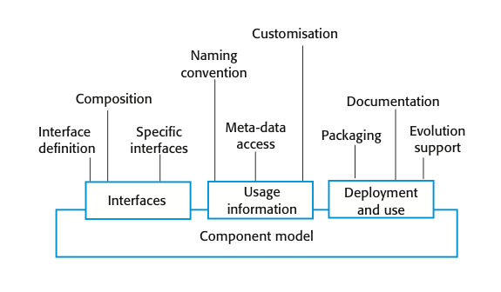
Basic elements of a component model
组件模型 的 基本元素
The diagram summarizes the model elements.图总结了模型的元素
It shows that the elements of a component model define the component interfaces, the information that you need to use the component in a program, and how a component should be deployed. More details are shown in next slide.
Chapter 17 Software reuse

Slide 18
Elements of a component model
组件模型的元素
Interfaces接口
  Components are defined by specifying their interfaces. The component model specifies how the interfaces should be defined and the elements, such as operation names, parameters and exceptions, which should be included in the interface definition.
Usage 使用
  In order for components to be distributed and accessed remotely, they need to have a unique name or handle associated with them. This has to be globally unique.
Deployment 部署
  The component model includes a specification of how components should be packaged for deployment as independent, executable entities.
Chapter 17 Software reuse

Slide 19
Elements of a component model
组件模型的元素
Interfaces接口
  组件是通过他们的接口来定义的，组件模型规定应如何定义组件接口以及在接口中应该包括的要素，如操作名、参数以及异常等.
Usage 使用
  为使组件远程分布和访问，需要给组件一个特定的名字或者句柄.
Deployment 部署
  组件模型包括一个描述，此描述说明应该如何打包组件使其部署成为一个独立的可执行的实体。
Chapter 17 Software reuse

Slide 20
Middleware support 组件模型 中间件支持
Component models are the basis for middleware that provides support for executing components.组件模型规定了必须由支持组件执行的中间件所提供的某些服务。
Component model implementations provide:
  Platform services that allow components written according to the model to communicate;平台服务
  Support services that are application-independent services used by different components.水平服务
  More details in next slide.
To use services provided by a model, components are deployed in a container. This is a set of interfaces used to access the service implementations.为了利用组件模型基础设施所提供的服务，你可以认为组件被部署在一个容器中，容器是支持服务的一个实现
Chapter 17 Software reuse

Slide 21
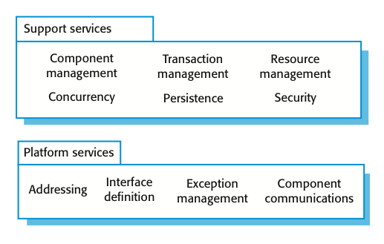
Middleware services defined in a component model
中间件服务 中 定义的 组件模型
  Platform services, which enable components to communicate and interoperate in a distributed environment. These are the fundamental services that must be available in all component-based systems;
  Support services, which are common services that are likely to be required by many different components. For example, many components require authentication to ensure that the user of component services is authorized. It makes sense to provide a standard set of middleware services for use by all components. This reduces the costs of component development and potential component incompatibilities can be avoided.
Chapter 17 Software reuse

Slide 22
17.2 CBSE processes 基于组件的软件工程 过程
CBSE processes are software processes that support component-based software engineering.CBSE过程是支持基于组件的软件工程的软件过程
  They take into account the possibilities of reuse and the different process activities involved in developing and using reusable components.他们考虑了复用的可能性，以及开发和使用可复用组件中涉及的不同过程活动 存在以下两种CBSE过程
Development for reuse面向复用的开发
  This process is concerned with developing components or services that will be reused in other applications. It usually involves generalizing existing components.(reuse-oriented)
Development with reuse 基于复用的开发
  This process is the process of developing new applications using existing components and services.(reuse-based)
Chapter 17 Software reuse

Slide 23
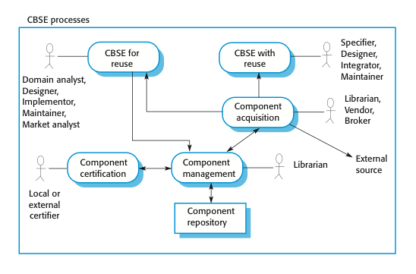
CBSE processes 基于组件的软件工程 过程
  The basic processes of CBSE with and for reuse have supporting processes that are concerned with component acquisition, component management, and component certification. More details in next slide.
  基于复用和面向复用的基本CBSE过程支持那些与组件获得、组件管理和组件认证有关的过程。
Chapter 17 Software reuse

Slide 24
Supporting processes 支持过程
——组件获得、管理、认证
Component acquisition is the process of acquiring components for reuse or development into a reusable component.组件获得是得到面向复用的组件或开发成一个可复用组件的过程。
  It may involve accessing locally-developed components or services or finding these components from an external source.
Component management is concerned with managing a company’s reusable components, ensuring that they are properly catalogued, stored and made available for reuse.组件管理是有关管理一个企业的可复用组件，以确保他们得以正确分类和存储，使面向复用成为可能
Component certification is the process of checking a component and certifying that it meets its specification.软件认证是检查组件和证实这个组件符合它的描述的过程。
Chapter 17 Software reuse

Slide 25
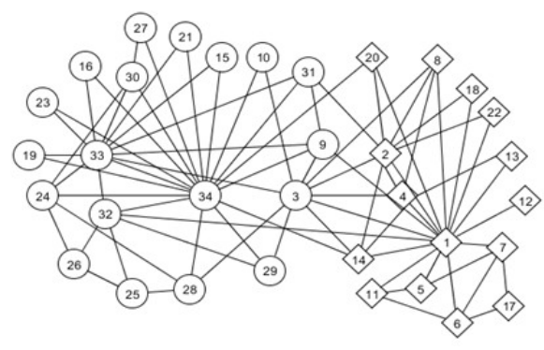

Key points
CBSE is a reuse-based approach to defining and implementing loosely coupled components into systems.
A component is a software unit whose functionality and dependencies are completely defined by its interfaces.
A component model defines a set of standards that component providers and composers should follow.
The key CBSE processes are CBSE for reuse and CBSE with reuse.
Chapter 17 Software reuse

Slide 26
17.2.1 CBSE for reuse 面向复用的CBSE
CBSE for reuse focuses on component development.
Components developed for a specific application usually have to be generalized to make them reusable.
A component is most likely to be reusable if it associated with a stable domain abstraction 稳定域抽象(business object).
For example, in a hospital stable domain abstractions are associated with the fundamental purpose - nurses, patients, treatments, etc.在医院管理系统中，领域抽象可能包括病人、治疗和护士。
Chapter 17 Software reuse

Slide 27
Component development for reuse 组件开发的重用
Components for reuse may be specially constructed by generalising existing components.
Component reusability 组件重用性
  Should reflect stable domain abstractions;应该反映稳定域抽象
  Should hide state representation;应该隐藏状态的表示
  Should be as independent as possible;应该独立
  Should publish exceptions through the component interface.应该通过组件接口 发布异常
There is a trade-off between reusability and usability重用性和实用性的权衡
  The more general the interface, the greater the reusability but it is then more complex and hence less usable.
Chapter 17 Software reuse

Slide 28
Changes for reusability 可重用性 的 改变
Changes that you may make to a component to make it more reusable include:可提高组件重用性的变更包括：
Remove application-specific methods.去掉那些应用特定的放法
Change names to make them general.更名使其更通用
Add methods to broaden coverage添加方法提供更完备的功能覆盖
Make exception handling consistent为所有方法构造一致的异常处理过程.
Add a configuration interface for component adaptation.添加“配置”接口允许对组件进行调整以使用不同的使用情况。
Integrate required components to reduce dependencies集成所需的组件以增强独立性.
Chapter 17 Software reuse

Slide 29
Exception handling 异常处理
Components should not handle exceptions themselves, because each application will have its own requirements for exception handling.组件不应该处理自身的异常，因为每个应用程序都有自己对异常处理的需求
  Rather, the component should define what exceptions can arise and should publish these as part of the interface.
In practice, however, there are two problems with this:
  Publishing all exceptions leads to bloated interfaces that are harder to understand. This may put off potential users of the component.
  The operation of the component may depend on local exception handling, and changing this may have serious implications for the functionality of the component.
Chapter 17 Software reuse

Slide 30
Exception handling 异常处理
组件不应该处理自身的异常，因为每个应用程序都有自己对异常处理的需求
  组件应该定义哪些会是产生的异常并将之发发布作为接口的一部分.
实际情况是，这里存在两个问题:
  发布所有的异常将导致太多的接口，这样更加难以理解，这可能会丢掉组件的潜在用户.
  组件的运行可能依靠局部异常处理，改变它将严重影响组件的功能.
Chapter 17 Software reuse

Slide 31
Legacy system components·
遗留系统组件
Existing legacy systems that fulfil a useful business function can be re-packaged as components for reuse.
现有的遗留系统完成了很重要的业务功能，可以被封装，作为组件来重用。
This involves writing a wrapper component that implements provides and requires interfaces then accesses the legacy system.
Although costly, this can be much less expensive than rewriting the legacy system.
Chapter 17 Software reuse

Slide 32
Reusable components 可重用的组件
The development cost of reusable components may be higher than the cost of specific equivalents同等设备. This extra reusability enhancement cost should be an organization rather than a project cost.
Generic components may be less space-efficient and may have longer execution times than their specific equivalents.
Chapter 17 Software reuse

Slide 33
Component management 组件的管理
Component management involves deciding how to classify the component so that it can be discovered, making the component available either in a repository or as a service, maintaining information about the use of the component and keeping track of different component versions.管理包括如何对组件进行分类，才可以发现它，使现有的组件是可用的，或者在存储库中或作为一个服务，维护有关组件的使用信息和保存不同组件的版本记录
A company with a reuse program may carry out some form of component certification before the component is made available for reuse.做复用项目的公司在组件成为可复用组件之前，要执行某种形式的组件认证。
  Certification means that someone apart from the developer checks the quality of the component. 意味着除了开发者之外，可能还有些人要检查这个组件的质量
Chapter 17 Software reuse

Slide 34
17.2.2 CBSE with reuse 基于复用的CBSE
CBSE with reuse process has to find and integrate reusable components.搜索和整合可复用组件
When reusing components, it is essential to make trade-offs between ideal requirements and the services actually provided by available components.
The process involves:过程包括：
  Developing outline requirements;
  Searching for components then modifying requirements according to available functionality.
  Searching again to find if there are better components that meet the revised requirements.
  Composing components to create the system.
  Figured in next slide.
Chapter 17 Software reuse

Slide 35
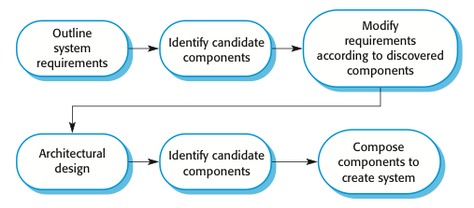
CBSE with reuse
基于复用的CBSE流程的主要活动
  The principal activities of CBSE with reuse process
  The essential differences between CBSE with reuse and software processes for original software development are:基于复用的CBSE与先前的软件开发过程之间的主要不同在于：
  The user requirements are initially developed in outline rather than in detail, and stakeholders are encouraged to be as flexible as possible in defining their requirements.
  Requirements are refined and modified early in the process depending on the components available.
  There is a further component search and design refinement activity after the system architecture has been designed.
  Development is a composition process where the discovered components are integrated.
Chapter 17 Software reuse

Slide 36
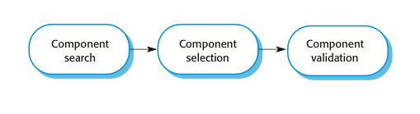
The component identification process
组件识别过程
  An activity that is unique to the CBSE process is identifying candidate components or services for reuse. This involves a number of subactivities, as shown in the following figure:
  Initially, your focus should be on search and selection.
  You need to convince yourself that there are components available to meet your requirements.
  Obviously, you should do some initial checking that the component is suitable but detailed testing may not be required.
  In the later stage, after the system architecture has been designed, you should spend more time on component validation确认、生效.
  You need to be confident that the identified components are really suited to your application; if not, then you have to repeat the search and selection processes.
Chapter 17 Software reuse

Slide 37
The component identification process
组件识别过程
  CBSE过程的一个独特活动是为复用识别组件和服务，这包括一系列的子活动，
  你的注意力集中于搜集和选择.
  使自己相信有可复用组件能满足需求.
  显然，应该做一些初始的检查看组件是否合适但不需要做详细测试.
  在后期阶段，在系统体系结构设计完成后，应将更多的时间用于组件的有效性验证上.
  你需要确信所识别出的组件真正适合你的应用，若不能，必须重复搜索和选择过程.
Chapter 17 Software reuse

Slide 38
Component identification issues
组件识别问题
Trust.信任 You need to be able to trust the supplier of a component. At best, an untrusted component may not operate as advertised; at worst, it can breach your security.
Requirements.需求 Different groups of components will satisfy different requirements.
Validation.认证
  The component specification may not be detailed enough to allow comprehensive tests to be developed.
  Components may have unwanted functionality. How can you test this will not interfere with your application?
  More details in next slide.
Chapter 17 Software reuse

Slide 39
Component validation 模块功能验证
Component validation involves developing a set of test cases for a component (or, possibly, extending test cases supplied with that component) and developing a test harness to run component tests.包括一组测试用例，并开发测试程序去运行组件测试
  The major problem主要问题 with component validation is that the component specification may not be sufficiently detailed to allow you to develop a complete set of component tests.
As well as testing that a component for reuse does what you require, you may also have to check that the component does not include any malicious code or functionality that you don’t need. 测试可复用组件是你所需要的同时，你还必须检查这个组件不包括任何恶意的代码或者你不需要的功能。
Chapter 17 Software reuse

Slide 40
Ariane launcher failure – validation failure?
阿丽亚娜火箭失败——验证失败？
In 1996, the 1st test flight of the Ariane 5 rocket ended in disaster when the launcher went out of control 37 seconds after take off.
The problem was due to a reused component from a previous version of the launcher (the Inertial Navigation System) that failed because assumptions made when that component was developed did not hold for Ariane 5.
The functionality that failed in this component was not required in Ariane 5, the validation tests for the reused software were based on Ariane 5 requirements.(Because there were no requirements for the function that failed, no tests were developed. Consequently, the problem with the software was never discovered during launch simulation tests.)
More description: The cause of the problem was an unhandled exception when a conversion of a fixed-point number to an integer resulted in a numeric overflow. This caused the run-time system to shut down the inertial reference system and launcher stability could not be maintained. The fault had never occurred in Ariane 4 because it had less powerful engines and the value that was converted could not be large enough for the conversion to overflow.
Chapter 17 Software reuse

Slide 41
17.3 Component composition 构件合成
The process of assembling components to create a system(or another component).
Composition involves integrating components with each other and with the component infrastructure.
Normally you have to write ‘glue code’ to integrate components.
将组件组装以产生一个系统的过程
合成包括将组件和其他组件集成 且 与组件基础集成
通常你不得不写一个“胶水代码”来集成组件
Chapter 17 Software reuse

Slide 42
Types of composition 合成的类型
Sequential composition顺序合成 where the composed components are executed in sequence. This involves composing the provides interfaces of each component.
Hierarchical composition层次合成 where one component calls on the services of another. The provides interface of one component is composed with the requires interface of another.
Additive composition叠加合成 where the interfaces of two components are put together to create a new component. Provides and requires interfaces of integrated component is a combination of interfaces of constituent components.
Chapter 17 Software reuse

Slide 43
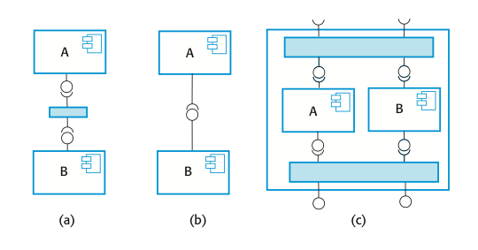
Types of component composition
组件合成的类型
Types of component composition
(a) Sequential composition(composing the provides interfaces, the services offered by component A are called, and the results returned by A are then used in the call to the services offered by component B. )
(b) Hierarchical composition(provides interface of one component is composed with the requires interface of other, these two interfaces must be compatible. Additional code may need if there is a mismatch between requires interface of A and provides interface of B.)
(c) Additive composition(Provides and requires interfaces is a combination of the corresponding interfaces in components A and B. The components are called separately through the external interface of the composed component. A and B are not dependent and do not call each other.)
Chapter 17 Software reuse

Slide 44
Interface incompatibility
3 种 接口不兼容
Parameter incompatibility参数不兼容 where operations have the same name but are of different types.
Operation incompatibility操作不兼容 where the names of operations in the composed interfaces are different.
Operation incompleteness操作不完备 where the ‘provides’ interface of one component is a subset of the ‘requires’ interface of another.
In all cases, you tackle the problem of incompatibility by writing an adapter that reconciles the interfaces of the two components being reused. An adaptor component converts one interface to another.对所有情况，都必须通过编写适配器组件来解决不兼容的问题，适配器组件使两个可复用组件的接口相一致。适配器组件将一个的接口转换为另一个的接口。
Chapter 17 Software reuse

Slide 45
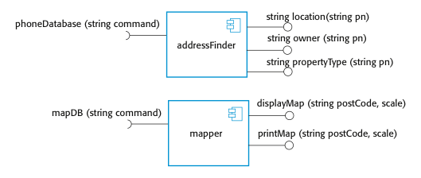
Components with incompatible interfaces
接口不兼容 的 组件
To illustrate adaptors适配器, consider the two components shown below, whose interfaces are incompatible:
These might be part of a system used by the emergency services(simplified).
When the emergency operator takes a call, the phone number is input to the addressFinder component to locate the address.
Then using the mapper component, the operator prints a map to be sent to the vehicle dispatched to the emergency.
The component addressFinder finds the address that matches a phone number. The mapper component takes a post code and displays or prints a street map of the area around that code at a specified scale.
Chapter 17 Software reuse

Slide 46
Adaptor components 适配器组件
Address the problem of component incompatibility by reconciling the interfaces of the components that are composed.
Different types of adaptor are required depending on the type of composition.
An ‘addressFinder’ and a ‘mapper’ component may be composed through an adaptor that strips the postal code from an address and passes this to the mapper component.
Chapter 17 Software reuse

Slide 47
Composition through an adaptor通过适配器组成
The component ‘postCodeStripper’ is the adaptor that facilitates the sequential composition of ‘addressFinder’ and ‘mapper’ components.
‘postCodeStripper’ takes the location data from ‘addressFinder’ and strips out the post code. This post code is then used as an input to ‘mapper’ and the street map is displayed at a scale of 1:10,000. The following code, which is an example of sequential composition, illustrates the sequence of calls that is required to implement this:
    Address=addressFinder.location(phonenumber);
    Postcode=postCodeStripper.getPostCode(address);
    Mapper.displayMap(postCode,10000);
Chapter 17 Software reuse

Slide 48
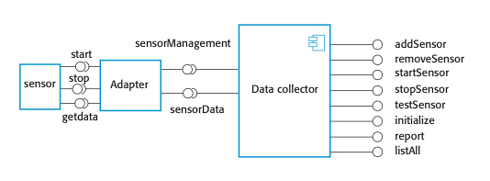
An adaptor linking a data collector and a sensor
链接 数据采集器 和 传感器的适配器
The use of an adaptor in the following Figure where an adaptor is used to link a ‘Data Collector’ and a ‘sensor’ component. These could be used in the implementation of a wilderness weather station system.
A separate ‘adaptor’, which converts the sensor commands from ‘Data collector’ to the actual sensor interface, is implemented for each type of sensor.
The ‘Data Collector’ component has been designed with a generic ‘requires’ interface that supports sensor data collection and sensor management.
For each of these operations, the parameter is a text string representing the specific sensor commands. For example, to issue a ‘collect’ command, you would say sensorData(“collect”).
The adaptor parses the input string, identifies the command(e.g., collect) and then calls Sensor.getdata() to collect the sensor value. It then returns the result(as a character string) to the ‘Data Collector’ component. This interface style means that the data collector can interact with different types of sensor.
The ‘sensor’ itself has separate operations such as ‘start’, ‘stop’, and ‘getdata’.
Chapter 17 Software reuse

Slide 49
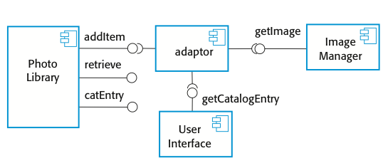
Photolibrary composition 图片库合成
The above discussion of component composition assumes you can tell from the component documentation whether or not interfaces are compatible.
Of course, the interface definition includes the operation name and parameter types, so you can make some assessment of the compatibility from this.
To illustrate this problem, consider the composition shown in the figure:
These components are used to implement a system that downloads images from a digital camera and stores them in a photograph library.
Photo Library Composition
Chapter 17 Software reuse

Slide 50
Interface semantics 接口语义
You have to rely on component documentation to decide if interfaces that are syntactically compatible are actually compatible.
Consider an interface(methods in the inteface) for a PhotoLibrary component:
public void addItem (Identifier pid; Photograph p; CatalogEntry photodesc);
public Photograph retrieve (Identifier pid);
public CatalogEntry catEntry (Identifier pid);
Chapter 17 Software reuse

Slide 51
Photo Library documentation 图片库文档化
Assume that the documentation for the ‘addItem’ method is:
“This method adds a photograph to the library and associates the photograph identifier and catalogue descriptor with the photograph.”
This description appears to explain what the component does, but consider the following questions:
“what happens if the photograph identifier is already associated with a photograph in the library?”
“is the photograph descriptor associated with the catalogue entry as well as the photograph i.e. if I delete the photograph, do I also delete the catalogue information?”
There is not enough information in the informal description of ‘addItem’ to answer these questions. So some information based on Object Constraint Language(OCL) is added to the informal description. See next slide.
Chapter 17 Software reuse

Slide 52
The Object Constraint Language 对象约束语言
The Object Constraint Language (OCL) has been designed to define constraints that are associated with UML models.OCL是设计用来描述UML对象模型中的约束的
It is based around the notion of pre and post condition specification – common to many formal methods.
OCL allows you to express predicates that must always be true, that must be true before a method has executed; and that must be true after a method has executed. These are invariants, pre-conditions, and post-conditions. 允许你表达必为真的谓词，或者是在执行某个方法之前（之后）必为真的谓词，它们是不变量、前置条件和后置条件
To access the value of a variable before an operation, you add @pre after its name. Therefore, using ‘age’ as an example: 为了在操作前访问值，在名字后加@pre age=age@pre+1
This statement means that the value of ‘age’ after an operation is one more than it was before that operation.age值操作后比之前+1

Slide 53
The OCL description of the Photo Library interface· OCL描述照片库的接口
The following includes a specification for the addItem and delete methods in Photo Library:
-- The context keyword names the component to which the conditions apply
context addItem
-- The preconditions specify what must be true before execution of addItem
pre: PhotoLibrary.libSize() > 0
PhotoLibrary.retrieve(pid) = null
-- The postconditions specify what is true after execution
post:libSize () = libSize()@pre + 1
PhotoLibrary.retrieve(pid) = p
PhotoLibrary.catEntry(pid) = photodesc
context delete
pre: PhotoLibrary.retrieve(pid) <> null ;
post: PhotoLibrary.retrieve(pid) = null
PhotoLibrary.catEntry(pid) = PhotoLibrary.catEntry(pid)@pre
PhotoLibrary.libSize() = libSize()@pre-1
The next slide shows more details about the conditions.
Chapter 17 Software reuse

Slide 54
Photo library conditions照片库情况
As specified, the OCL associated with the Photo Library component states that(conditions for ‘addItem’ state):
Pre-conditions:前置条件
  There must not be a photograph in the library with the same identifier as the photograph to be entered;
  The library must exist - assume that creating a library adds a single item to it;
  Post-conditions:后置条件
  Each new entry increases the size of the library by 1;
  If you retrieve using the same identifier then you get back the photo that you added;
  If you look up the catalogue using that identifier, then you get back the catalogue entry that you made.
Chapter 17 Software reuse

Slide 55
Composition trade-offs 合成权衡（这种）
When composing components, you may find conflicts between functional and non-functional requirements, and conflicts between the need for rapid delivery and system evolution.功能性需求和非功能性需求之间，尽快移交软件和创建一个能够随时变更而进化的系统之间都存在着潜在的冲突
You need to make decisions such as:
  What composition of components is effective for delivering the functional requirements?
  What composition of components allows for future change?
  What will be the emergent properties of the composed system?
Chapter 17 Software reuse

Slide 56
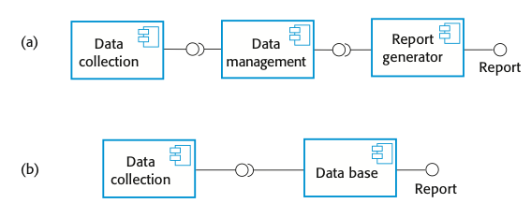

Data collection and report generation components数据收集 和 报告生成组件
  Consider a situation such as that illustrated in the figure, where a system can be created through two alternative compositions:
  In composition(b), a database component with built-in reporting facilities(e.g., Microsoft Access) is used.
  The key advantage of composition(b) is that there are fewer components, so this will be a faster implementation because there are no component communication overheads.
  Furthermore, data integrity rules that apply to the database will also apply to reports. These reports will not be able to combine data in incorrect ways. In composition(a), there are no such constraints so errors in reports could occur.
In general, a good composition principle to follow is the principle of separation of concerns. That is, you should try to design your system in such a way that each component has a clearly defined role and that, ideally, these roles should not overlap.
  There is a potential conflict between adaptability and performance:
  Composition (a) is more adaptable;
  (b) is perhaps faster and more reliable.
  The advantages of composition (a) are that reporting and data management are separate, so there is more flexibility for future change. The data management system could be replaced and, if reports are required that the current reporting component cannot produce, that component can also be replaced without having to change the data management component.
Chapter 17 Software reuse

Slide 57
Key points
During the CBSE process, the processes of requirements engineering and system design are interleaved.
Component composition is the process of ‘wiring’ components together to create a system.
When composing reusable components, you normally have to write adaptors to reconcile different component interfaces.
When choosing compositions, you have to consider required functionality, non-functional requirements and system evolution.
在基于组件的软件工程开发流程中,需求工程和系统设计的过程是交错的。
组件组合是“连接”组件共同创建一个系统的过程。
在编写可重用的组件时,你通常需要写适配器来调和不同的组件接口。
在选择组成成分时,你必须考虑需要的功能,非功能性需求和系统进化。
Chapter 17 Software reuse

